Slide 1

A Recommendation System for ModCloth
Newton Tran

Slide 2
What Are Recommendation Systems?
Type of machine learning that utilizes data to suggest items most relevant to the user
Two main types: collaborative filtering and content-based
Former uses user similarity, whereas the latter is exclusive to the item’s features (i.e. focuses on a specific user’s preferences rather than group or (type)
Two types of collaborative filtering: user=based and item-based
In the former, if any two given users have similar preferences or behaviors, they are likely to prefer items
In the latter, there is more focus on items that users have already interacted with

Slide 3
Why Recommendation Systems?
With so many choices, recommendation systems can streamline the customer experience
From a business standpoint, they can boost sales since they:
Increase personalization for the consumer → higher customer retention
Lead to more cross-selling
Lower marketing costs

Slide 4

Problem Statement
ModCloth is a brand that specializes in vintage-inspired women’s apparel, particularly in dresses. The goal is to build a recommendation system that recommends a user three products.

Slide 5
Data
Addressing Marketing Bias in Product Recommendations Mengting Wan, Jianmo Ni, Rishabh Misra, Julian McAuley, WSDM, 2020
Under df_modcloth.csv
The data contains over 99,893 reviews of 1020 unique products sold from ModCloth, from 44,783 unique users
Data spans over 9 years from 2010 – 2019
Five numerical features: item_id, rating, size, year, split
Seven object-type features: user_id, timestamp, fit, user_attr, model_attr, category, brand

Slide 6
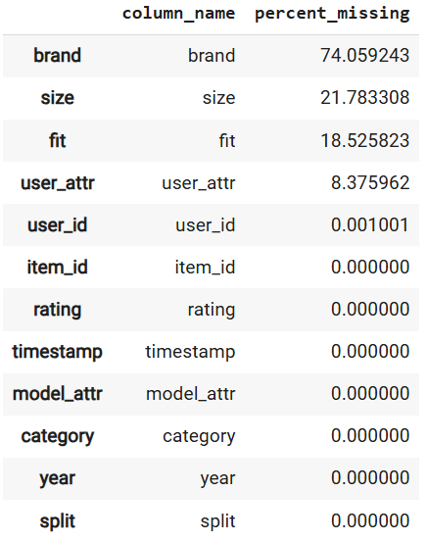
Missing Values
brand, size, fit, user_attr, and user_id contained missing values

Slide 7
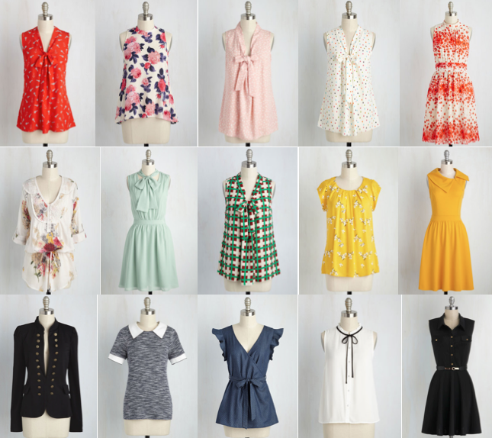
Exploratory Data Analysis

Slide 8
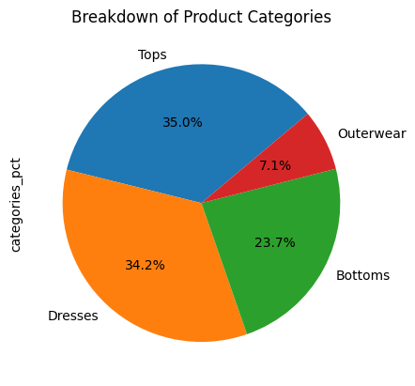
Product Categories
Tops, bottoms, and dresses are the predominant categories

Slide 9
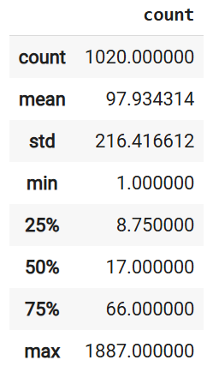
Summary Statistics of the Number of Ratings Per Unique Item
The average number of ratings is about 98, but this starkly contrasts to the median of 17 ratings
This also widely varies with a standard deviation of around 216 ratings

Slide 10
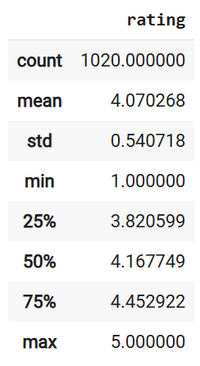
Average Rating For Each User
The average rating that a user gives is around 4, which is close to the median of about 4.17
This varies by about a standard deviation of 0.54

Slide 11
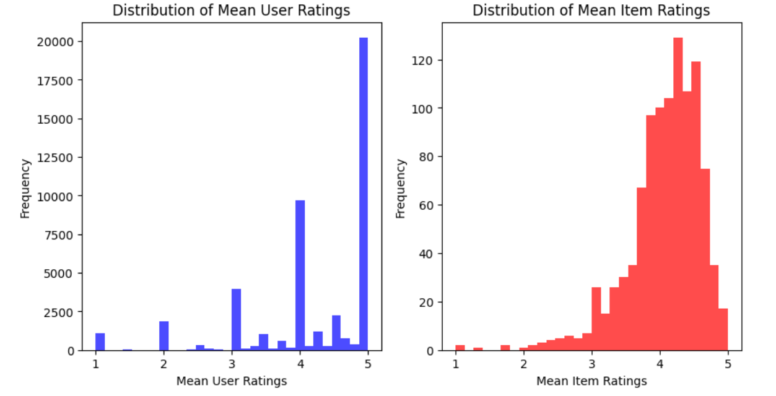
Distributions of Mean User Ratings and Mean Item Ratings
- Both share skewness, however we note that the ratings are concentrated between 4 and 5

Slide 12
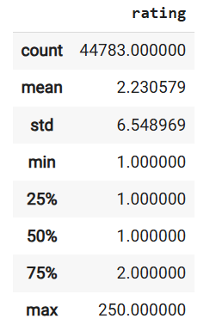
Summary Statistics of the Number of Ratings a User Has Submitted
The number of ratings submitted ranges from 1 to 250
On average, there are about 2 reviews submitted from any given user
This varies by about 6 to 7 reviews

Slide 13
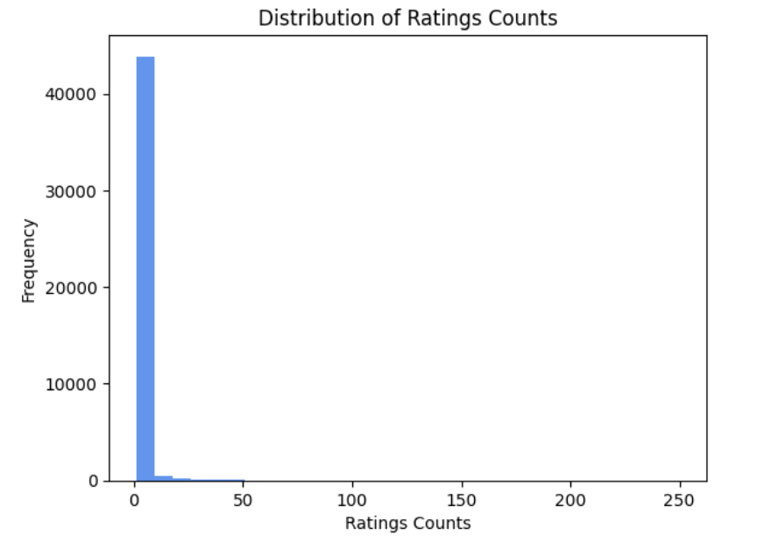
Distribution of the Number of Ratings a User Has Submitted
We see that most users have submitted around 2 reviews
Extreme right-skewness

Slide 14
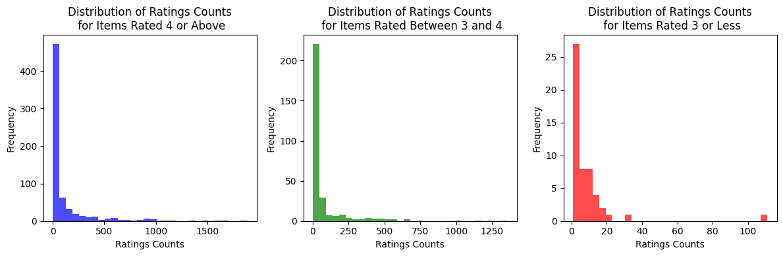
The Number of Ratings Counts, Given the Item’s Rating
- In all three cases, they all show right-skewness

Slide 15
Data Wrangling
Four features were extracted: item_id, user_id, rating,and category
Imputed one missing value of user_id with ‘Unknown’
Establish a notion of what is considered a “good” item
An item’s average rating was 4 or above
The item had at least 24 reviews
After filtering the data, the dataset was reduced to 93,915 reviews (rows), containing 435 unique items and 43,470 unique users
Subsequently saved as df_modcloth_filtered.csv

Slide 16
Data Wrangling
A separate dataset contained the most popular items through basic aggregation, which was grouped by item_id, and then sorted by average item rating and number of ratings, each in ascending order, was stored as pop_items.csv
A new feature, weighted_vals, was created by multiplying the average item rating by the number of ratings, then by a float between 700 and 1600 if the average item rating was 4 or above (else divided by 1000), and then finally added by a random float generated by 0 to 1
Ensures mapping between the item and its respective weighted_vals is bijective

Slide 17
Modeling
The recommendation system is split into two cases:
A user’s average rating is 4 or above. In this case, we will utilize item-based collaborative filtering
Else, a user’s average rating is below 4. In this case, we will only give generic recommendations based on the most popular items
For the first case, for model training and validation, a 50-50 stratified train-test split was done on the filtered dataset
A utility matrix was created off from the training dataset
Since the ratings were rank-based, Spearman’s correlation was preferred
Singular value decomposition (SVD) was then applied to the utility matrix
A k-nearest neighbors model of k = 10 was then constructed from that SVD-reduced utility matrix
k = 10 was chosen since we wanted to capture a sufficient, but not overly-excessive number of similar items, while also considering the model might capture a product that was already purchased by the user

Slide 18
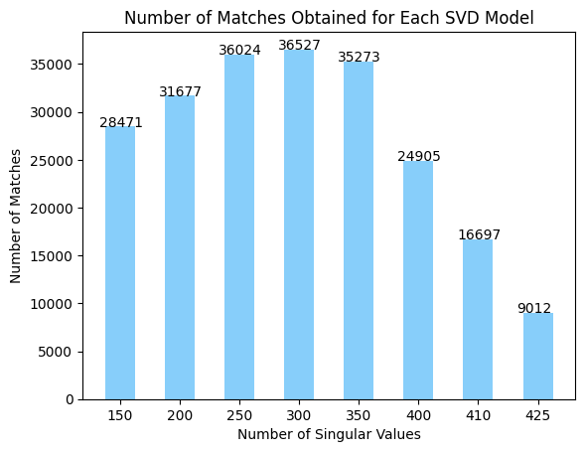
Model Metrics
A simple metric in determining the best model is to see how many matches were obtained between the model and the user’s actual purchases

Slide 19
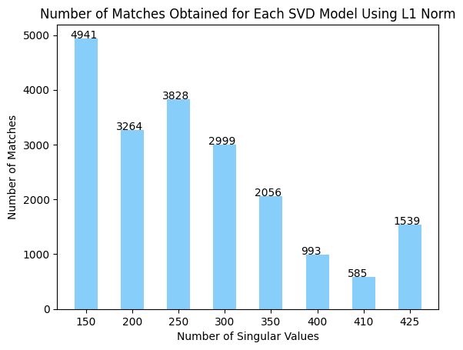
Model Metrics
By default, the k-nearest neighbors model used L2 norm (Euclidean distance), but we wanted to see how the number of matches would change by changing this hyperparameter to L1 norm (Manhattan distance)

Slide 20
Model Metrics
Number of Singular Values | RMSE
150 | 0.128778485257336
200 | 0.1019257880438485
250 | 0.08059295336375218
300 | 0.061961617379721494
350 | 0.04433289670423865
400 | 0.02500844225436355
410 | 0.020314003417670517
425 | 0.011552216980782718
The root mean squared error (RMSE) between the original utility matrix and its SVD-reduced version was also calculated

Slide 21
Conclusion
Data showed strong signs of skewness, which influenced the results of our recommendation system since items rated 4 or above were heavily emphasized, whereas those rated below 4 were heavily penalized
It’s possible that, for example, items rated between 3.7 to 3.9 might be “good” items
It’s hard to establish a solid notion of what is considered a “good” item since ratings are highly subjective and inconsistent
We can further understand the behavior of our recommendation system – more so the bias of our data - by applying sentiment analysis on the size and fit features

Slide 22
References
Addressing Marketing Bias in Product Recommendations
Mengting Wan, Jianmo Ni, Rishabh Misra, Julian McAuley
WSDM, 2020
IBM. “Collaborative Filtering.” Ibm.com, 21 Mar. 2024, www.ibm.com/think/topics/collaborative-filtering.
“Think | IBM.” Ibm.com, 2024, www.ibm.com/think/topievdelo.com/amazons-recommendation-algorithm-drives-35-of-its-sales/cs/collaborative-filtering. Accessed 16 Dec. 2024.
‌
Evdelo. “Amazon’s Recommendation Algorithm Drives 35% of Its Sales.” Evdelo, 2020, evdelo.com/amazons-recommendation-algorithm-drives-35-of-its-sales/.
Whiting, Rick. “Researchers Solve Netflix Challenge, Win $1 Million Prize | CRN.” Crn.com, 2024, www.crn.com/news/applications-os/220100498/researchers-solve-netflix-challenge-win-1-million-prize.

